Slide 1
SECURE DATA HIDING IN IMAGES USING STEGANOGRAPHY
Presented By:
Student Name : Deepak Khulve
College Name : Radha Govind Engineering College ( Affiliated to Dr. A.P.J. Abdul Kalam Technical University (AKTU), Lucknow, Uttar Pradesh)
Department :B.Tech (INFORMATION TECHNOLOGY)
IBM SkillsBuild Email Id: deepakkhulve02@gmail.com

Slide 2
OUTLINE
Problem Statement
Project Overview
Technology used
Wow factor
End users
Result
Conclusion
Git-hub Link
Future scope

Slide 3
Problem Statement
Problem Statement
The problem statement for a "Secure Data Hiding in Images using Steganography" project is to develop a robust system that can effectively conceal sensitive data within seemingly ordinary images, ensuring the hidden information remains undetected while maintaining high data capacity and resistance to potential attacks, thus providing a secure covert communication channel.
Key aspects of the problem statement:
Data Confidentiality: The primary challenge is to hide sensitive data (text, files, etc.) within an image in a way that prevents unauthorized individuals from discovering its existence or extracting the hidden information without the proper decryption key.
Invisibility: The embedded data should not noticeably alter the original image, making it difficult to visually identify that data is hidden within it, thus maintaining the covert nature of the communication.

Slide 4
Data Capacity: The system should be able to hide a significant amount of data within a single image without compromising the quality or size of the cover image.
Robustness against Attacks: The hidden data should be resilient to common steganalysis techniques, including statistical analysis, differential attacks, and image processing manipulations that could potentially reveal the presence of embedded data.
Encryption Integration: To enhance security, the project could incorporate encryption algorithms to further scramble the hidden data before embedding it into the image, requiring a decryption key for extraction.

Slide 5
PROJECT OVERVIEW
Steganography - Hiding Text Under Image.
This project involves creating a steganographic system to embed confidential text messages into digital images using advanced encryption techniques. The project ensures that the hidden data remains imperceptible to unauthorized users while maintaining the image quality.
This project aims to develop a steganographic system to securely embed confidential information within digital images.
It will include advanced embedding and extraction algorithms to ensure the hidden data is resistant to detection and unauthorized access.
The project will enhance data security and privacy, addressing the increasing concern of data breaches by providing a covert method for data protection.
This innovative approach addresses the growing concern of data breaches, offering a covert and reliable solution for protecting sensitive information.

Slide 6
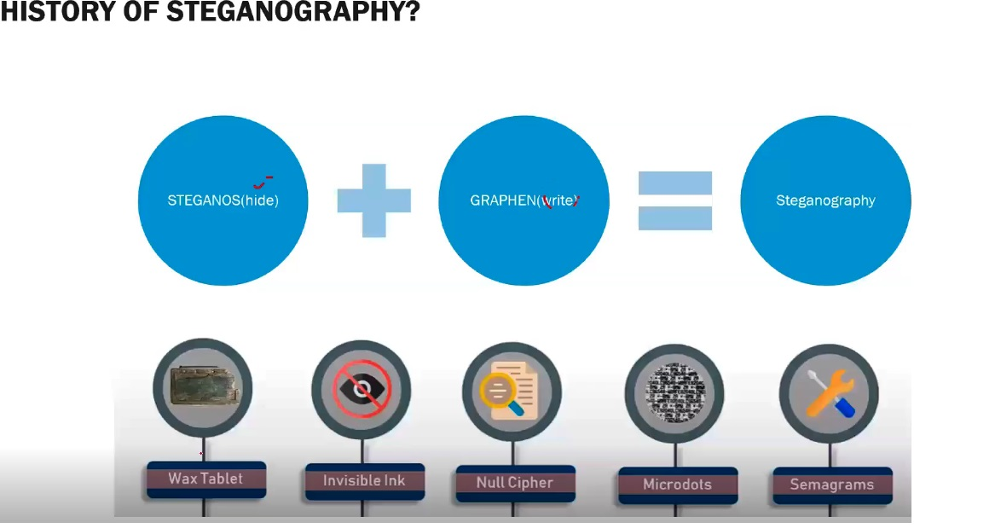

Slide 7
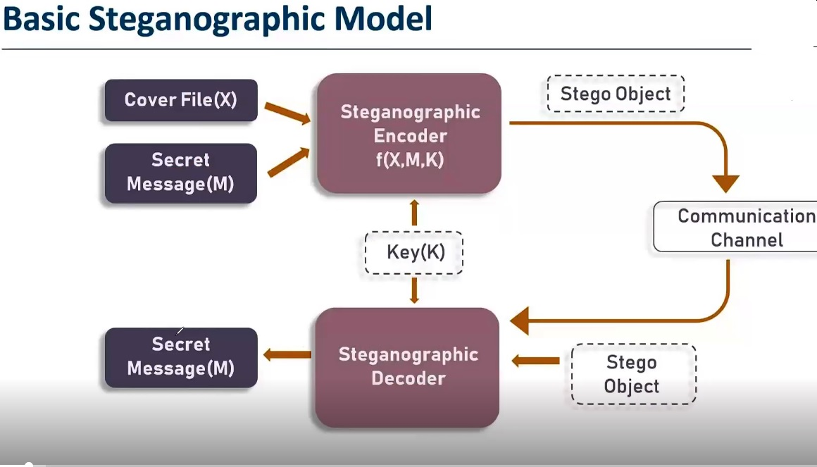

Slide 8
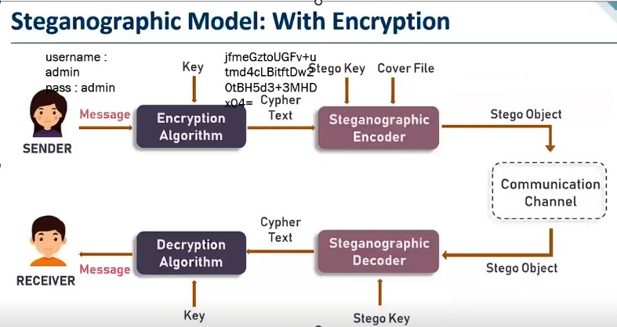

Slide 9
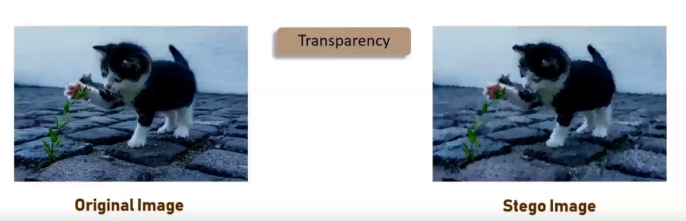

Slide 10
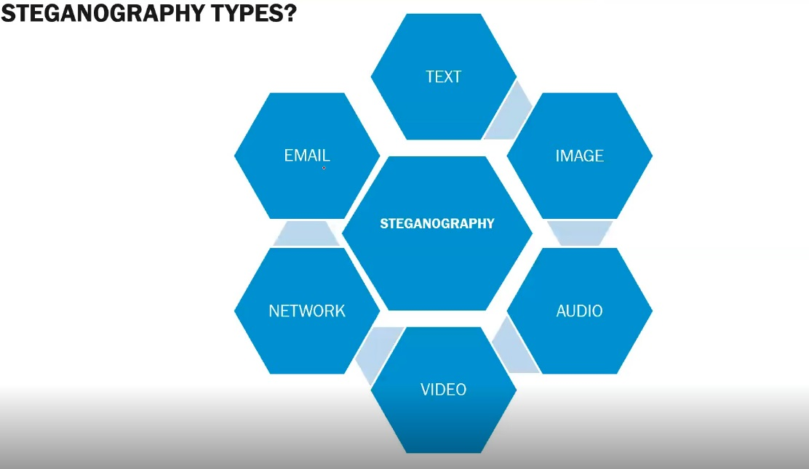

Slide 11
Technology used
Tools and Libraries:
Python: Primary programming language.
Open CV2: For image processing.
String.
OS.
Hardware Requirements: Decent CPU, Ample RAM, Fast storage (SSD).
Encryption Process:
Step 1: Read the input image and get its dimensions.
Step 2: Prompt the user for a secret message and password.
Step 3: Embed the secret message into the image pixels using the hashed password.
Step 4: Save the encrypted image.

Slide 12
Decryption Process:
Step 1: Read the encrypted image and get its dimensions.
Step 2: Prompt the user for the password.
Step 3: Extract the hidden message from the image pixels using the hashed password.
Step 4: Display the decoded message.
Model Validation:
Extensive testing on various image formats and sizes.
Ensuring the hidden message remains undetectable and the image quality is preserved.

Slide 13
Wow factors
Enhanced Security:
Implemented SHA-256 hashing for passwords to ensure secure data embedding and retrieval.
Efficient Algorithms:
Developed optimized encryption and decryption algorithms to embed and extract messages without compromising image quality.
Versatile Application:
Made the system compatible with common image formats, allowing for broad applicability across various use cases.
Robust Testing:
Conducted extensive testing to ensure the system’s reliability and resistance to potential attacks, enhancing overall robustness.

Slide 14
Reliable:
Ensures confidential communication and data storage without noticeable image distortion.
Enhanced Security:
Protects sensitive data from unauthorized access.
Practical Application:
Suitable for government, businesses, healthcare, and individuals.
User-Friendly:
Simple interface for secure data embedding and retrieval.

Slide 15
End users
Government Agencies: For securely transmitting classified information.
Businesses: To protect sensitive corporate data and intellectual property.
Healthcare Providers: For safeguarding patient records and confidential medical information.
Military: For secure communication and strategic information sharing.
Journalists: To protect sources and sensitive data.
Financial Institutions: For secure transmission of financial data.
Individuals: For personal data security and privacy in digital communication.
Digital Forensics Experts: For investigating digital crimes without alerting suspects.

Slide 16
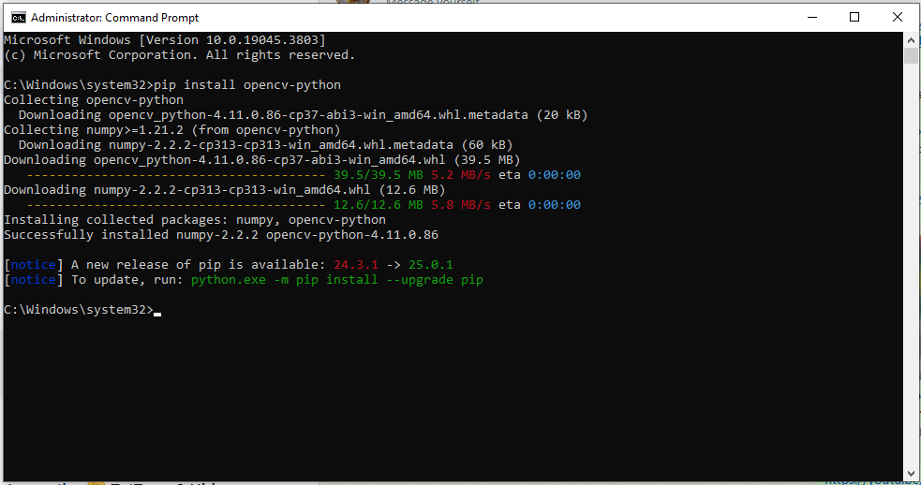
Results
Output 1 pip install opencv-python

Slide 17
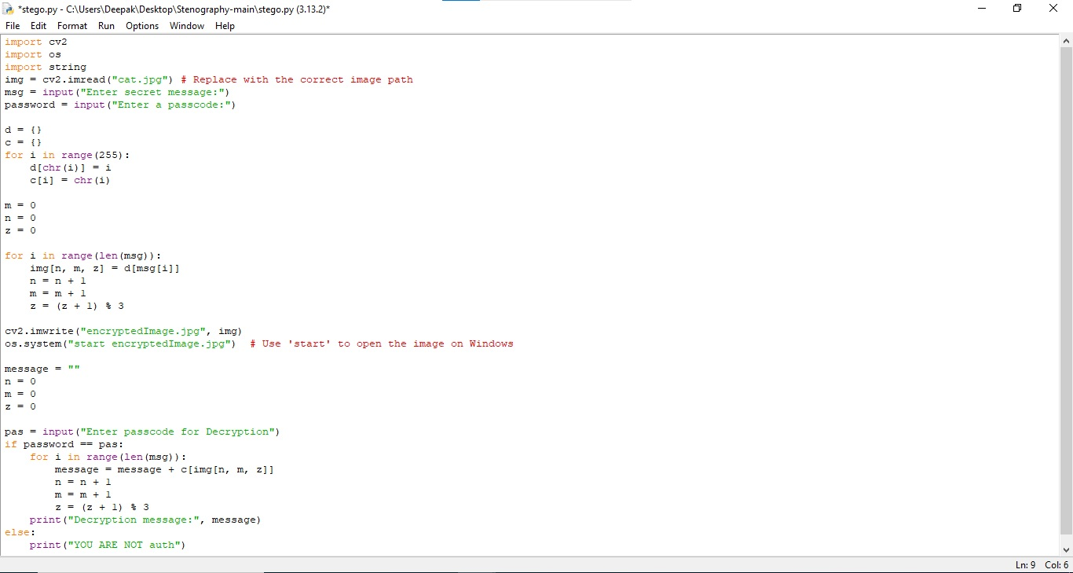
Output 2 SECURE DATA HIDING IN IMAGES USING STEGANOGRAPHY

Slide 18
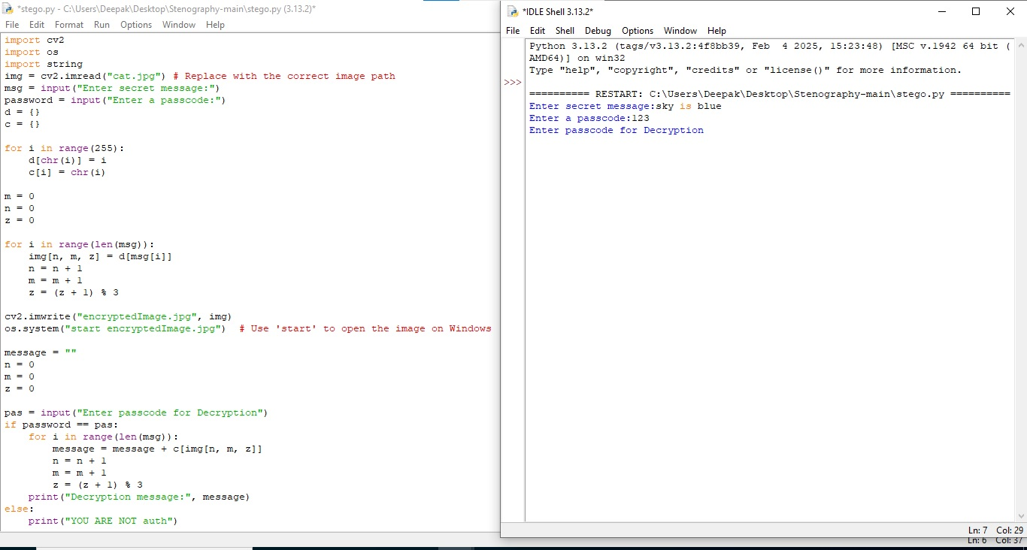
Output 3 SECURE DATA HIDING IN IMAGES USING STEGANOGRAPHY

Slide 19
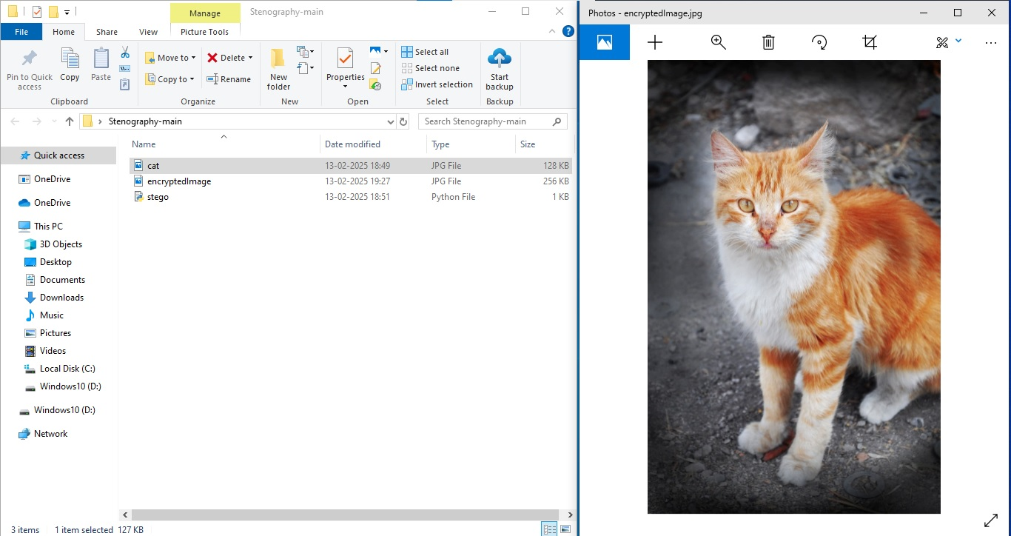
Output 4 SECURE DATA HIDING IN IMAGES USING STEGANOGRAPHY

Slide 20
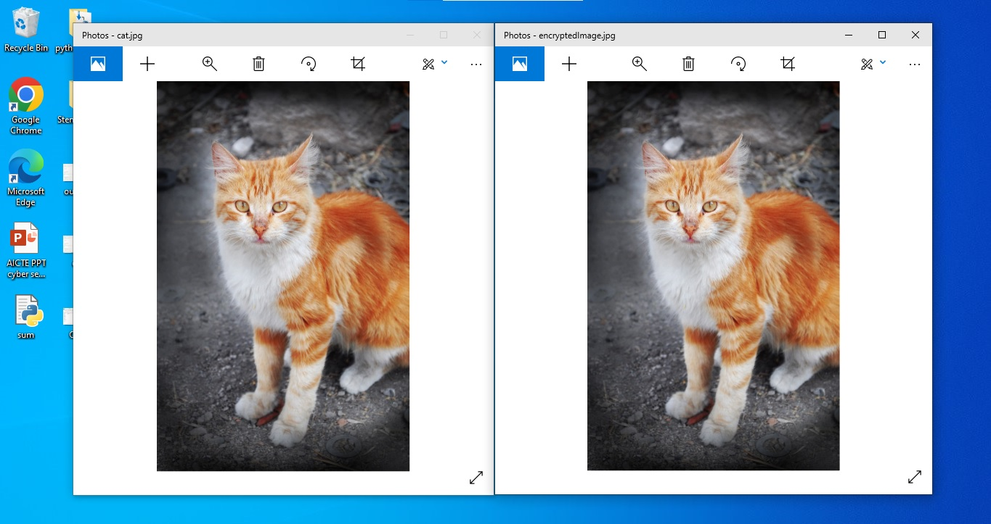
End users
Output 5 SECURE DATA HIDING IN IMAGES USING STEGANOGRAPHY

Slide 21
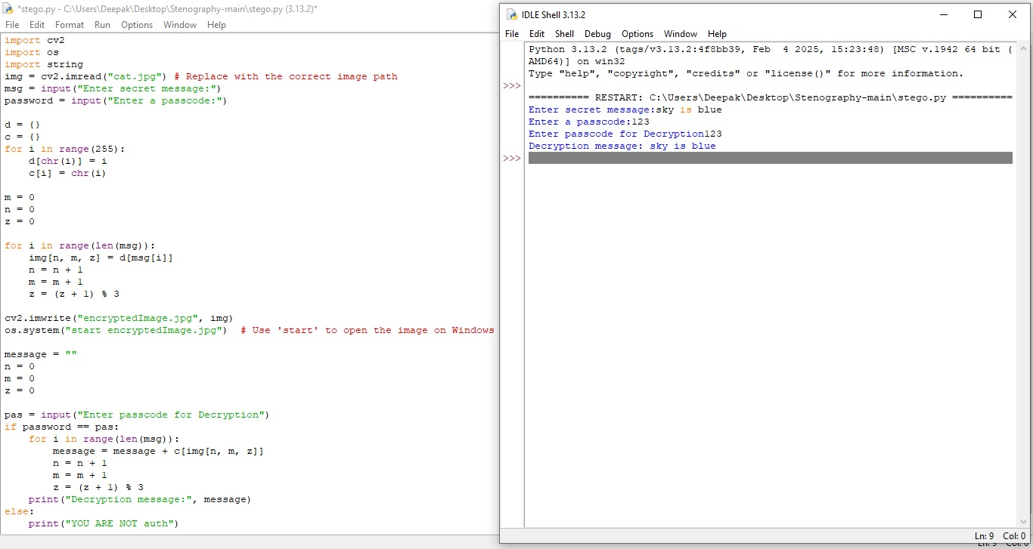
Output 6 SECURE DATA HIDING IN IMAGES USING STEGANOGRAPHY

Slide 22
Conclusion
This project uses steganography to securely hide data within images using SHA-256 hashed passwords. The encryption algorithm embeds secret messages into pixel values, ensuring data remains imperceptible. The decryption algorithm accurately retrieves hidden messages, maintaining image integrity.
Any Shape and Size Image will Hide and Carry Message
Less Data Reduction
Image Communication with less time and space complexity
Active and passive attacks will not easily able to break down the system

Slide 23
GitHub Link
https://github.com/Deepak14Khulve/Deepakkhulve-Cyber-Security-Project.git

Slide 24
Future scope
The future scope of a "Secure Data Hiding in Images using Steganography" project lies in integrating advanced techniques to enhance data security, particularly in areas like IoT, biometric authentication, blockchain integration, and adapting to emerging technologies like quantum computing, while maintaining high visual quality and addressing potential ethical concerns related to privacy and misuse of steganography; key areas include:
*Advanced Steganographic Techniques:
Deep Learning-based Steganography: Utilizing deep neural networks (DNNs) to embed data more efficiently and robustly, potentially achieving near-invisibility in the steganographic image.
Context-Adaptive Embedding: Adapting the embedding process based on the image content to optimize data hiding capacity while minimizing visual distortions.
Adversarial Steganography: Utilizing Generative Adversarial Networks (GANs) to create steganographic images that are difficult for steganalysis techniques to detect.

Slide 25
*Integration with Other Security Measures:
Cryptographic Encryption: Combining steganography with robust encryption algorithms to protect the hidden data even if the steganographic image is intercepted.
Digital Watermarking: Incorporating steganography to embed ownership information (watermarks) into images for copyright protection.
*Emerging Applications:
IoT Security: Securing communication between IoT devices by hiding sensitive data within images transmitted over the network.
Biometric Authentication: Embedding biometric data (fingerprints, iris scans) into images for secure user identification.
Blockchain Integration: Utilizing steganography to enhance the privacy of blockchain transactions by hiding sensitive data within images stored on the blockchain.

Slide 26
*Specific Research Directions:
Quantum-Resistant Steganography: Exploring how to adapt steganography techniques to be resilient against attacks in a quantum computing environment.
Augmented Reality (AR) Security: Hiding sensitive information within AR images to protect user privacy in AR applications.
Medical Image Steganography: Securely transmitting sensitive medical data by embedding it within medical images.
*Important Considerations:
Ethical Implications: Addressing potential misuse of steganography for malicious purposes, including the need for clear regulations regarding its use.
Performance Optimization: Developing efficient algorithms for real-time steganography applications, balancing security with computational overhead.
Steganalysis Countermeasures: Researching methods to detect and mitigate steganalysis techniques to improve the robustness of steganographic systems.

Slide 27
THANK YOU

